Slide 1
Bug life cycle
Svyatoslav Dyuhanchuk

Slide 2
What is a Bug?
A defect is non-conformance to requirements or functional specification.
A bug can be result of incorrect environment, configuration or data.

Slide 3
Defect Report
The aim is to defect report describing the problems that most clearly that developers can easily reproduce the defect and correct it.
Bug Tracking Systems
Bug tracking system is a software application that is designed to help quality assurance and developers to keep track of reported software bugs in their work.

Slide 4
Bug Tracking Systems
Bugzilla
JIRA
Mantis
HP ALM/ Quality Center
FogBugz
IBM Rational ClearQuest
Lighthouse
Zoho bug tracker
The Bug Genie
BugHost

Slide 5
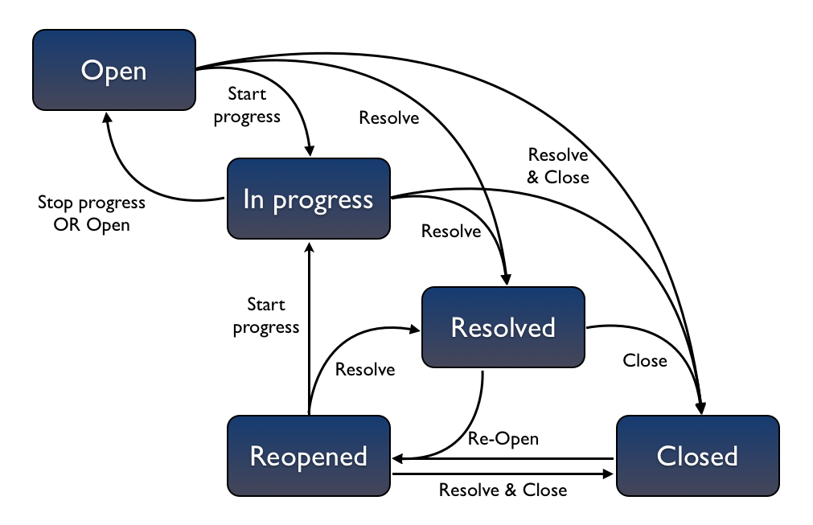
JIRA Bug Lifecycle

Slide 6

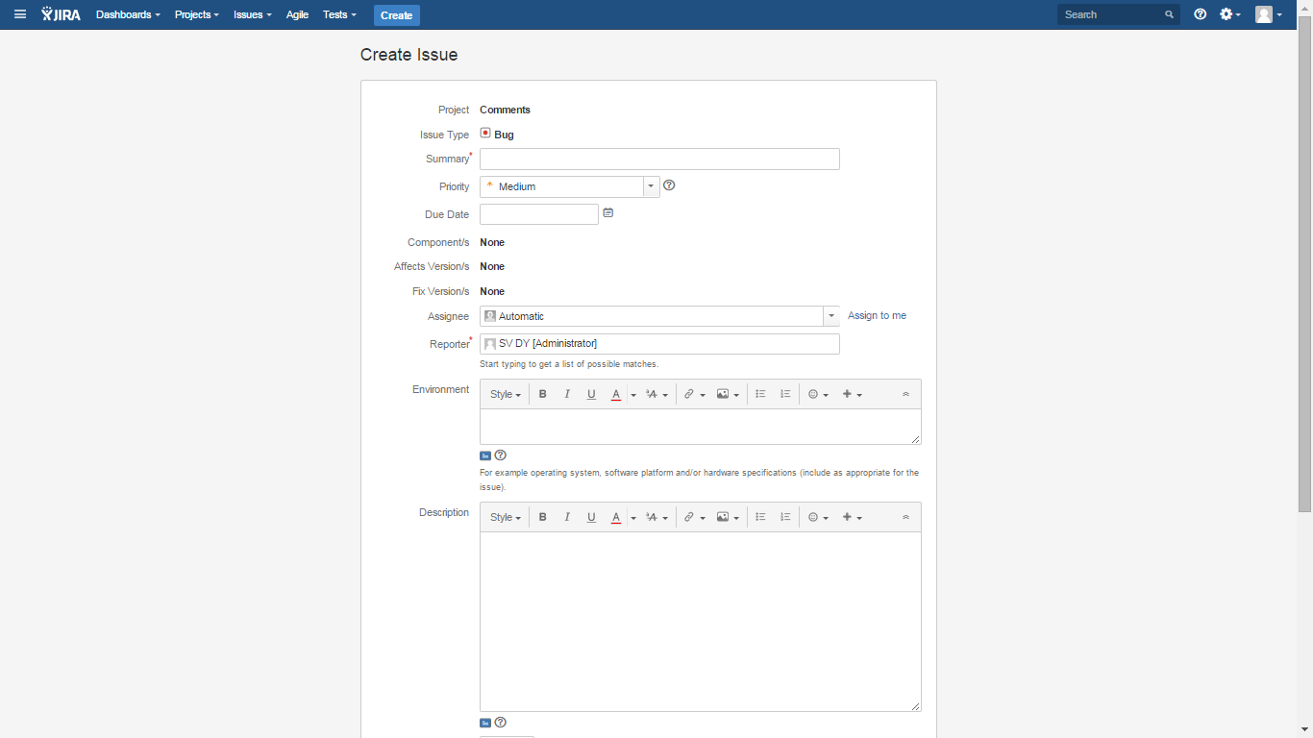

Slide 7
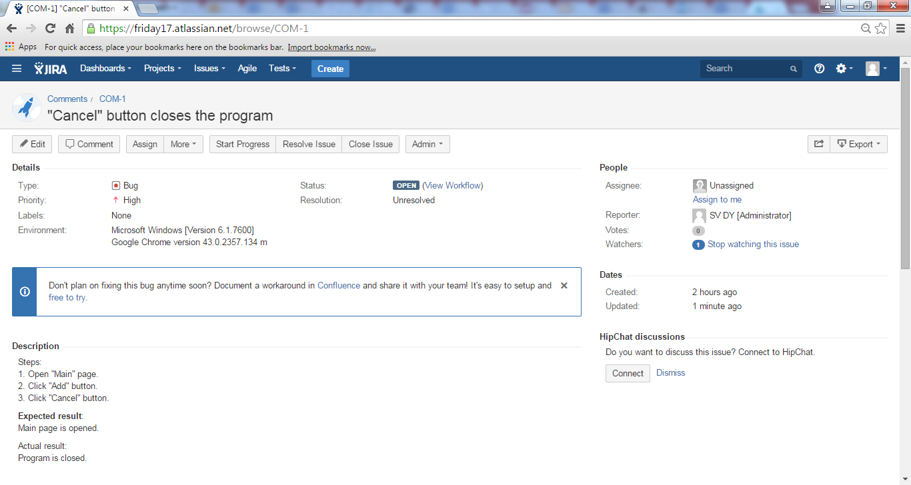

Slide 8
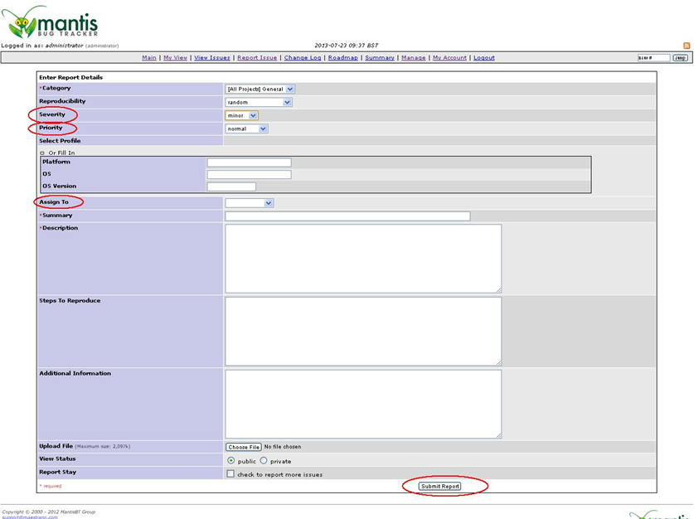

Slide 9
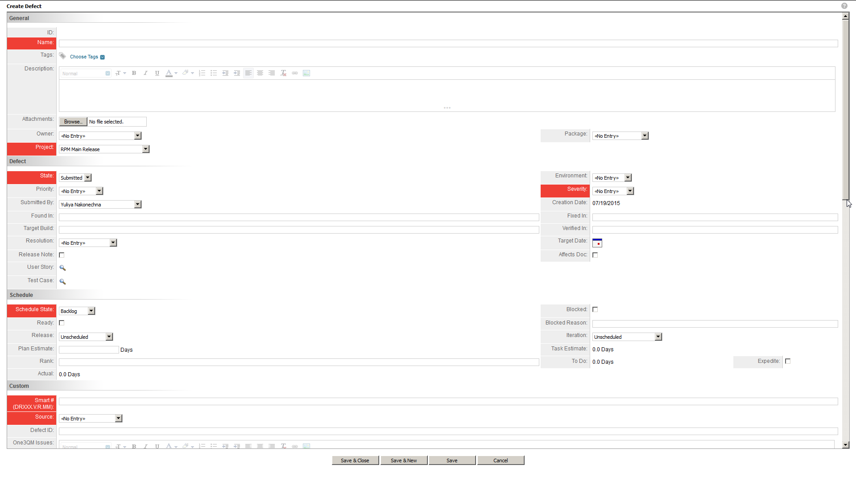

Slide 10
Bug Report Attributes: Summary
The ideal summary gives the reader enough information to understand what the problem is.
This is a short description of the problem. Summary is important part of the bug’s report. It should include a brief description that is specific enough in order the reader could visualize the failure.

Slide 11
Bug Report attributes: Description
Give detailed and clear enough and correct description of a problem. Summary is not an appropriate place for detailed description. Do not rely on the summary only.

Slide 12
Bug Report attributes: Description
Give detailed and clear enough and correct description of a problem. Summary is not an appropriate place for detailed description. Do not rely on the summary only.

Slide 13
Bug Report attributes: Priority
Priority tells us how soon it is desired to have a bug fixed. Priority can be assigned by Development Team Lead, Project Manager or Customer.
Possible values are:
High. “Fix it ASAP, I cannot live with this"
Medium. “Please, correct this till the end of the phase“
Low. "It would be nice to have this fixed if"

Slide 14
Bug Report attributes: Severity
Severity tells us how bad the defect is. It defines the seriousness of the bug or its consequence. It’s assigned by Tester.
Critical. This should be reserved for the most catastrophic problems only, e.g. a component, module or area crashes or not accessible.
Major. Data loss, crash of the major functionality.
Medium. A problem that effects a more isolated piece of functionality.
Minor. A cosmetic problem, minor errors in layout/formatting.

Slide 15
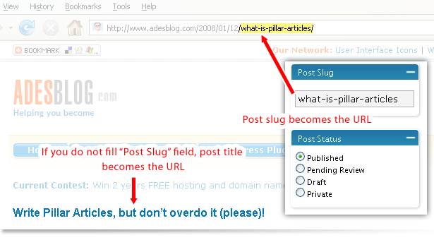
Bug Report attributes: Attachments

Slide 16
Bug Report attributes: Attachments
PrtScr (Alt + PrtScr)
Lightshot
Jing
Aviary
Clip2Net
Faststone Capture
Greenshot
KingKong Capture
ScreenDash
Screenpresso

Slide 17


